Slide 1


PROJECT 6: Descriptive, predictive analysis and visualization in Tableau
Date: Monday Jan. 24th 2022
GROUP 3 PRESENTATION
Payments Data
Presented by:
Anna SHIN
Zijing XUE
Nadim SAAD

Slide 2


Project Goals:
Develop a dashboard in Tableau reflecting the descriptive & predictive analysis of data and explain the state of the payments.
PROJECT REQUIREMENTS
Use Trello for the project management (tasks description)
Examine the dataset
Develop the system of Key Performance Indicators :
Average time for transaction
Status of payment
Total charges per period
Payment status forecast
Issues in correspondence chain
Probability of delay
Troubles forecast
Create a User Story
Prepare 12 widgets describing our data
At least 3 widgets reflecting forecasted values
Prepare a readme file and upload all files to GitHub

Slide 3
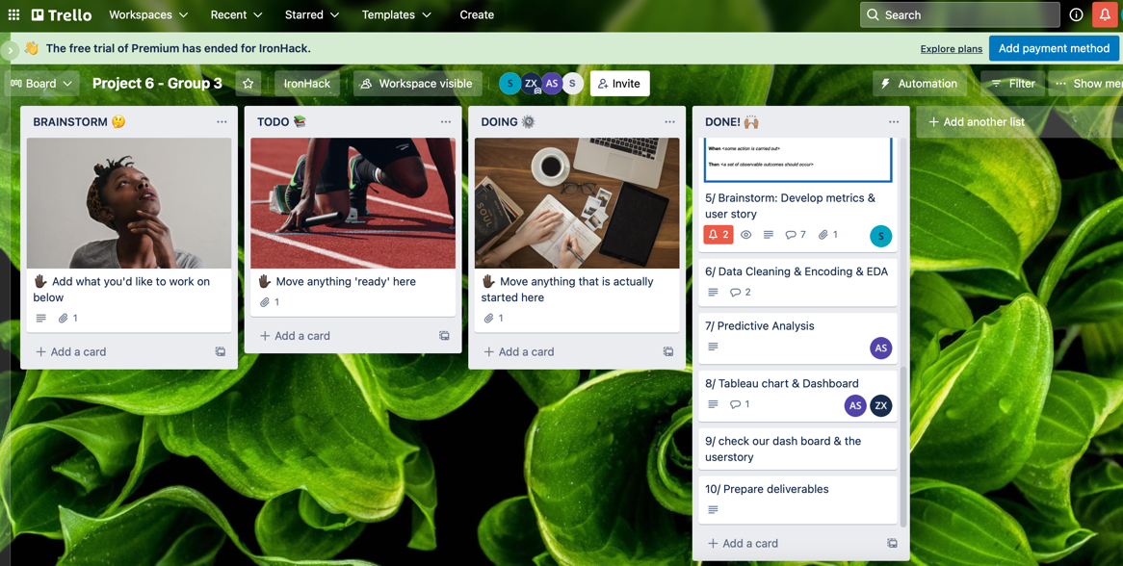
Project Management: Trello – Project 6 (Group 3)

Slide 4
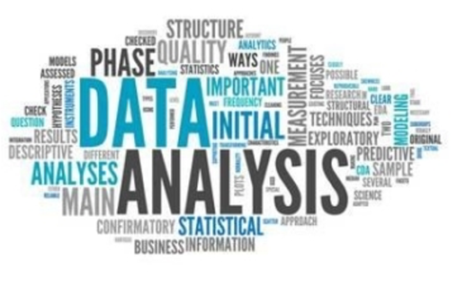
Dataset Examination: Descriptive and Predictive Analysis
DATASET EXAMINATION
The dataset was relatively clean with minor changes in certain dates and numbers
The descriptive and predictive analysis of the Data were made on Python as we had to do several grouping and calculations to obtain the needed widgets and perform the required forecasts

Slide 5
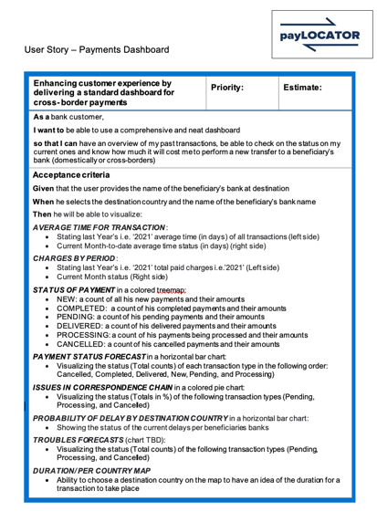
Create a User Story

Slide 6
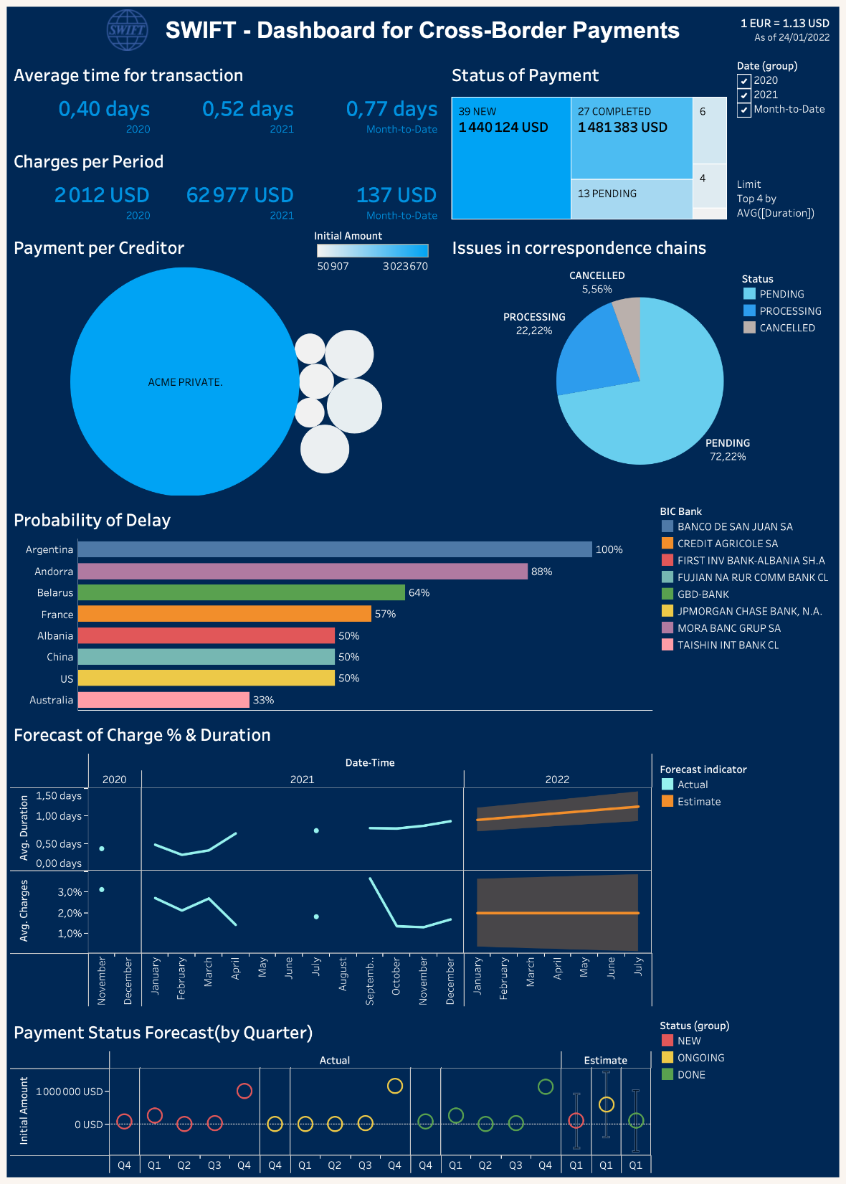

Slide 7

Any Questions?
Notes:
You can safely remove this slide. This slide design was provided by SlideModel.com – You can download more templates, shapes and elements for PowerPoint from http://slidemodel.com

